Slide 1
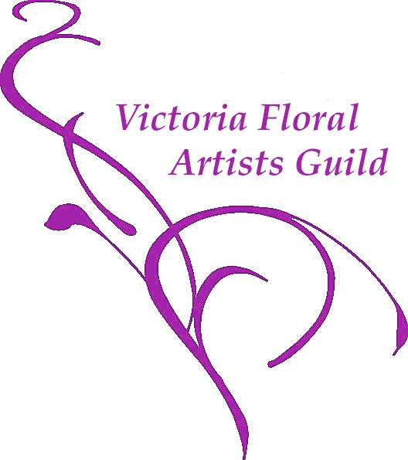
A Retrospective Exhibit of Floral Design Since 1900
Presented by Victoria Floral Artists Guild
Garth Homer Centre, 813 Darwin Avenue
7 pm, Tuesday, October 8, 2019

Slide 2
Objective
To offer members a selection of broad categories of design styles to challenge their creativity and showcase their skills.

Slide 3
Floral Design Time Line
1890 – 1910 Art Nouveau
1920’s & 1930’s Art Deco
1940’s & 1950’s Modern
1960’s & 1980’s Geometric Mass – Traditional
1980’s & 1990s Geometric Mass – Modern
2000 – 2019 Contemporary
Pre World War II

Slide 4
A Note About Design Styles
Geometric designs span the 20th century to the present in both the traditional and modern styles
Ikebana and its use of asymmetry as a design principle permeates designs throughout the 20th century to the present.

Slide 5
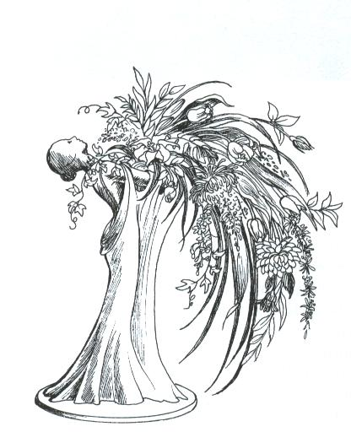
Art Nouveau (1890 – 1910)
Curvilinear lines
Asymmetrical
Patterned after nature
Moving, playful, swinging, cascading lines and forms
Shapes of plants, flowers as well as the human form

Slide 6
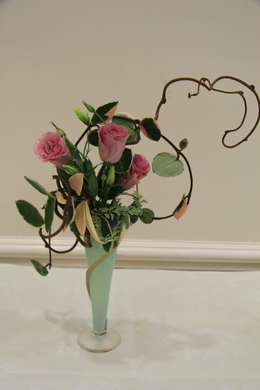
Art Nouveau

Slide 7
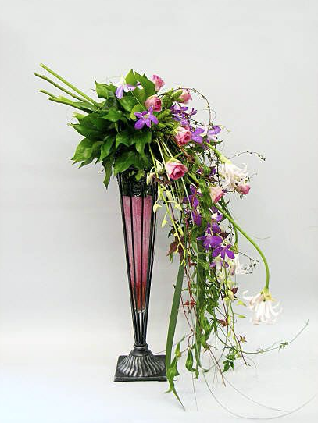
Art Nouveau

Slide 8
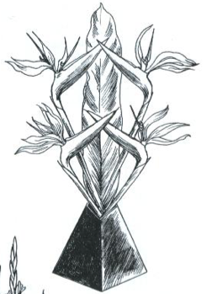
Art Deco (1920 – 1940)
Strong streamlined geometric designs, forms and patterns
Includes zigzags, pyramids and sunburst motifs
Art Deco belongs to the
world of luxury and
decadence!

Slide 9
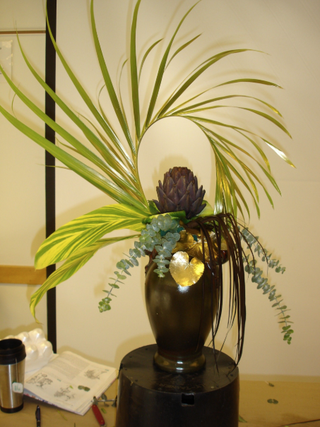
Art Deco

Slide 10
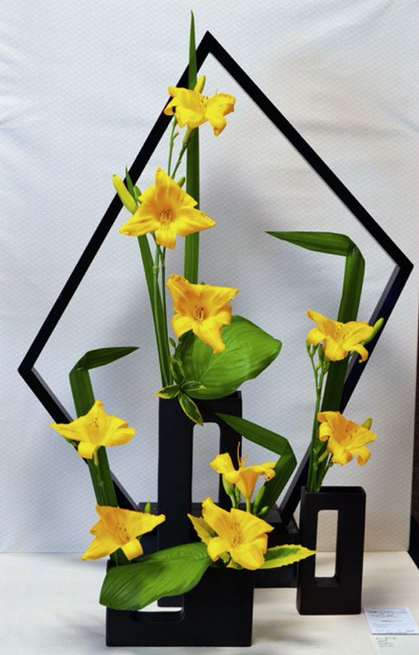
Art Deco

Slide 11
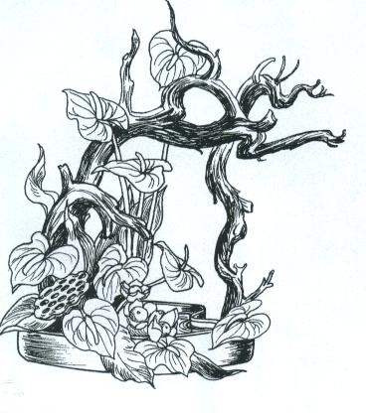
Modern (1940’s & 1950’s)
Sparse, sophisticated designs
Modern, natural appearance
Expressive with a feeling and movement
Imaginative use of small amounts of material
Use of driftwood and figurines

Slide 12
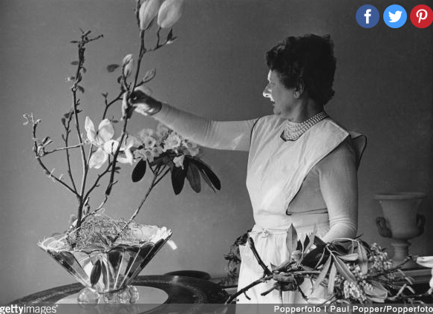
Modern

Slide 13
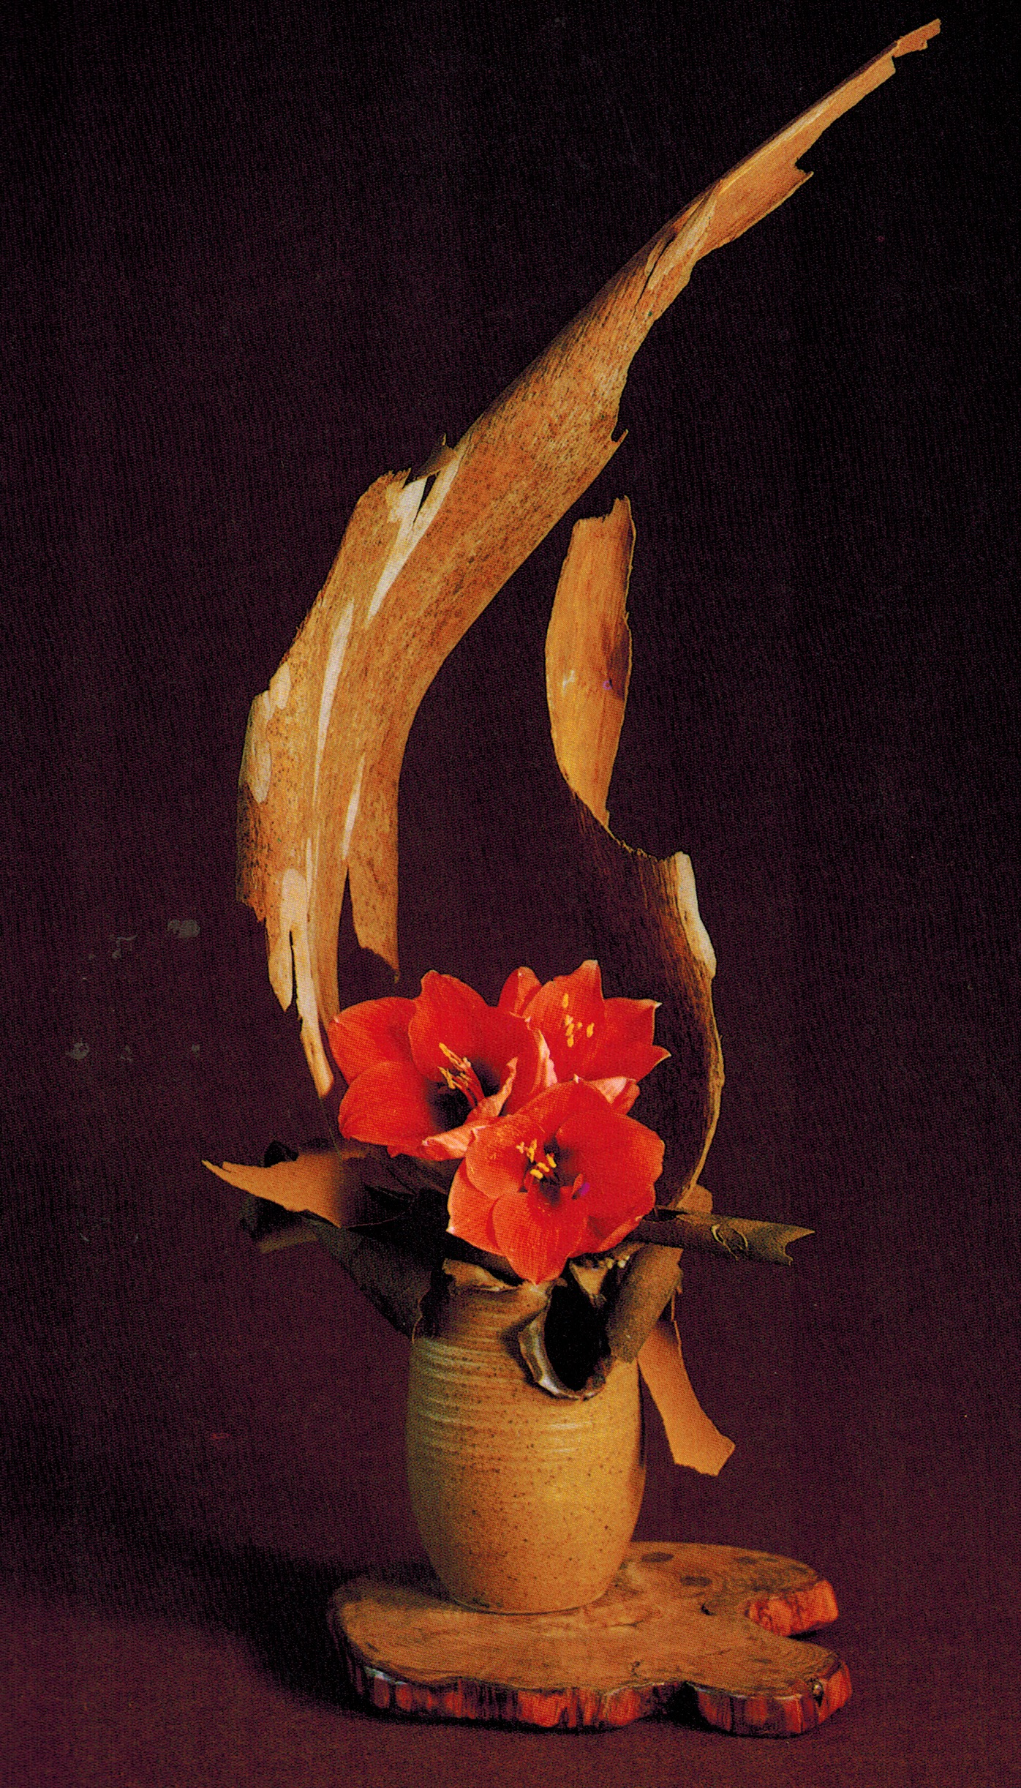
Modern

Slide 14
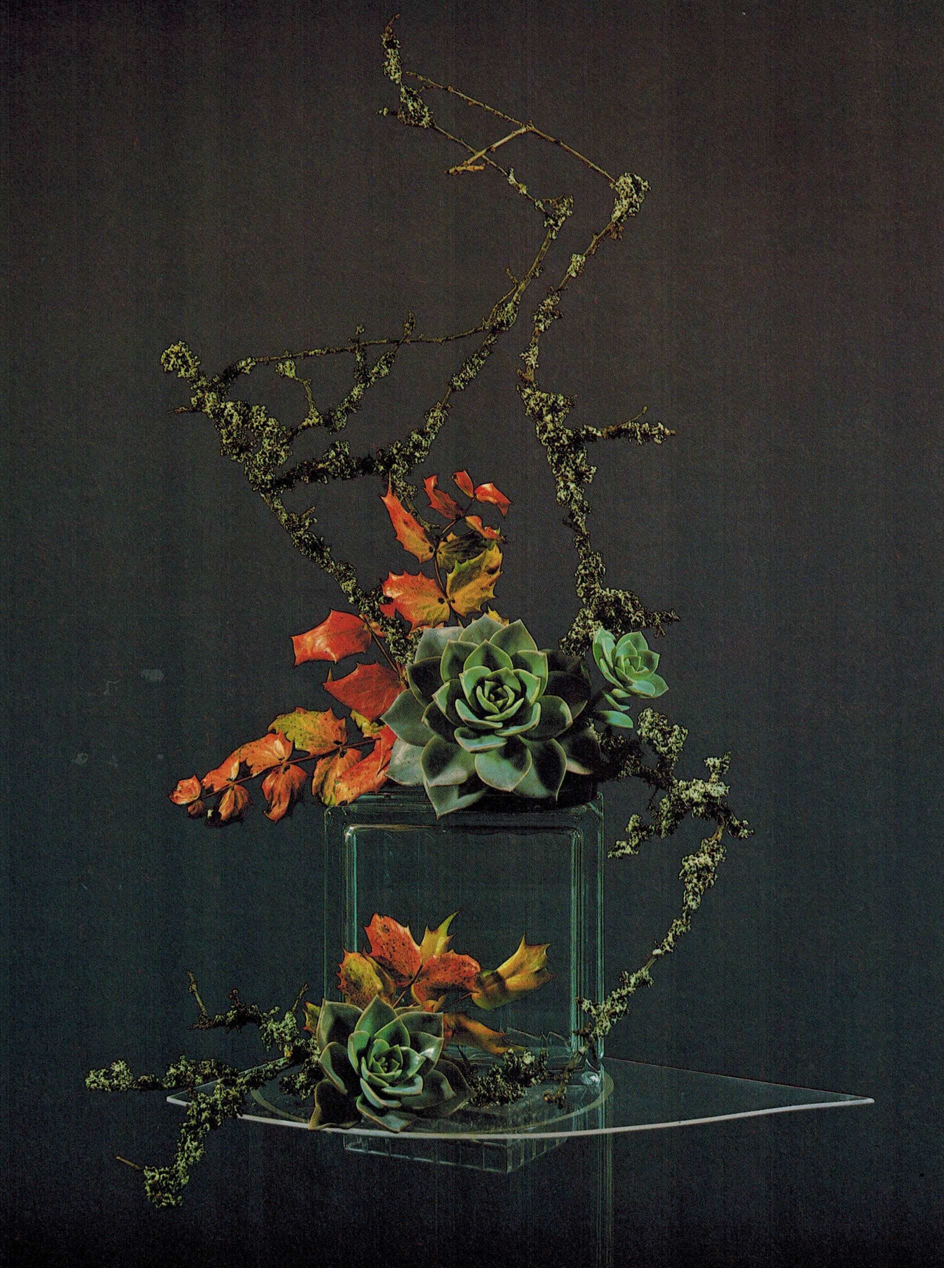
Modern

Slide 15
Geometric Design -- Traditional 1960’s & 1970’s
Designs based on geometric forms
Tight bouquets symmetrical and asymmetrical
One centre of interest where all lines converge
No crossed lines are evident
Graceful rhythm created by gradation of line, texture, colour and flower form
Designs are finished on back

Slide 16
Geometric Forms

Slide 17
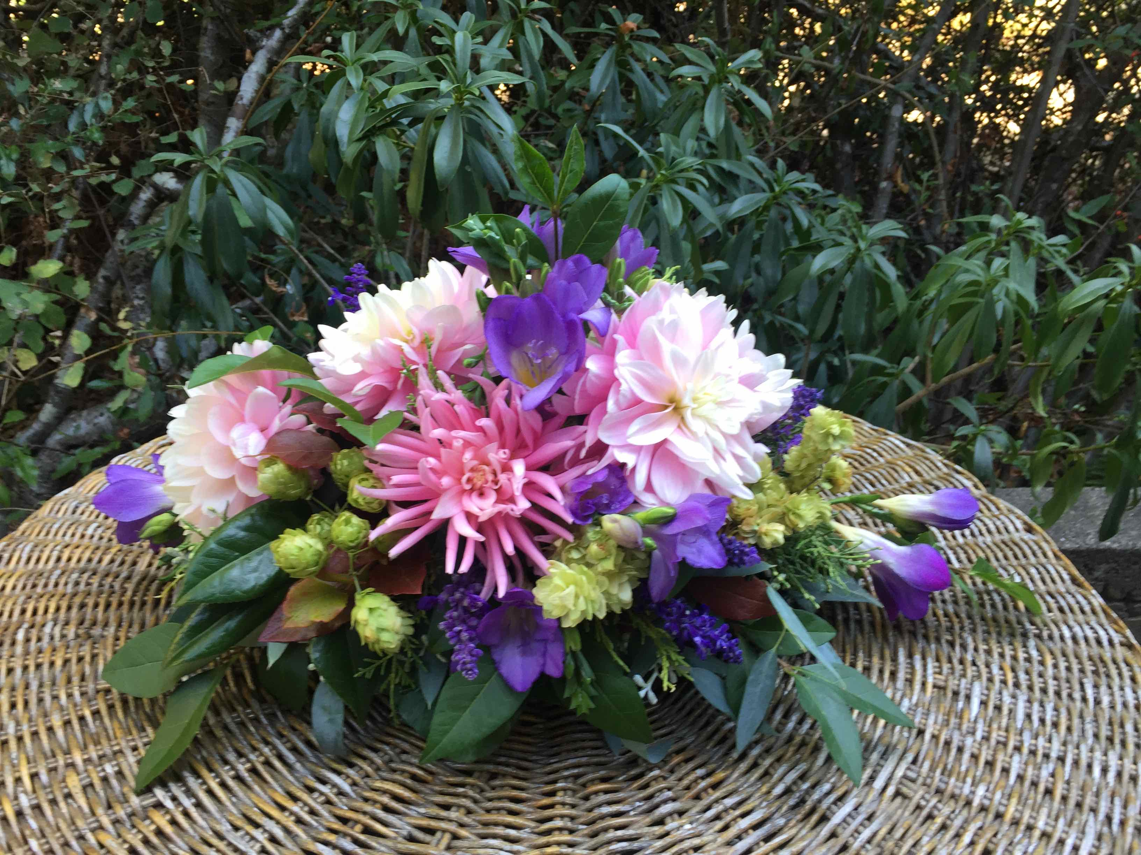
Geometric Design - Traditional

Slide 18
Geometric Design - Traditional

Slide 19
Geometric Design – Modern 1980’s - 2000
Streamlined design with few flowers
Adherence to geometric forms

Slide 20
Geometric Design - Modern

Slide 21
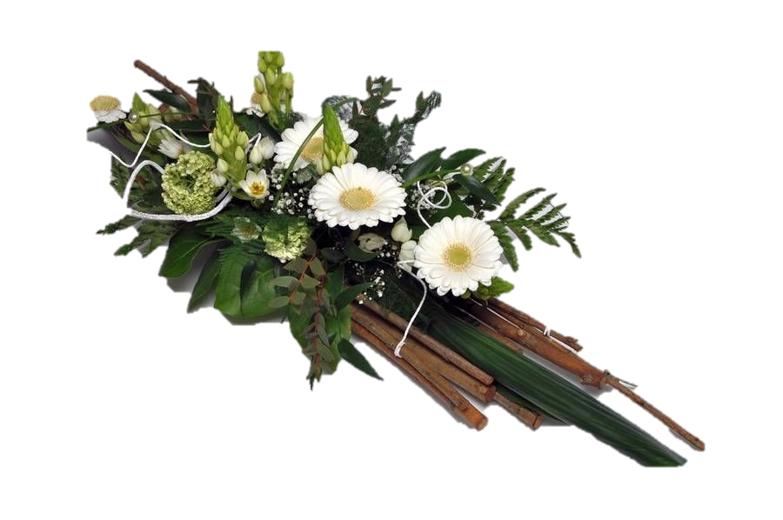
Geometric Design - Modern

Slide 22
Contemporary – 2000 to Present
May have more than one focal point and one point of emergence
Little transitional material
Containers integral part of the design
Mechanics often intentionally part of design
Structures a marked feature of contemporary
Plant material used in blocks and groups of one colour or shape

Slide 23
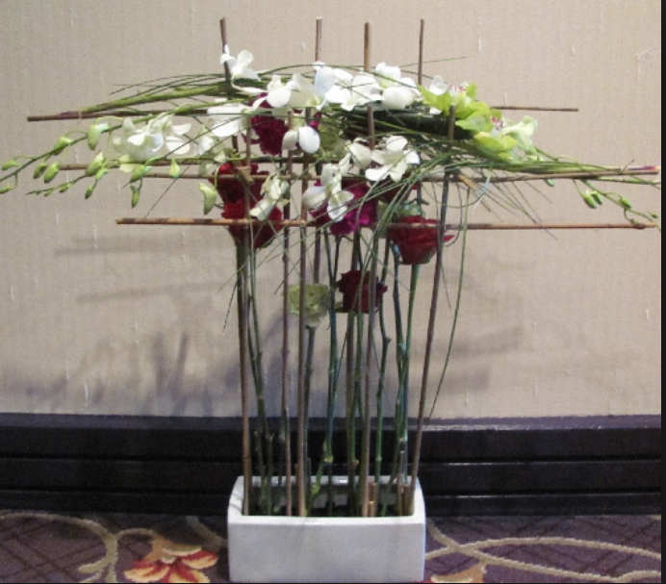
Contemporary
Hitomi Gilliam

Slide 24
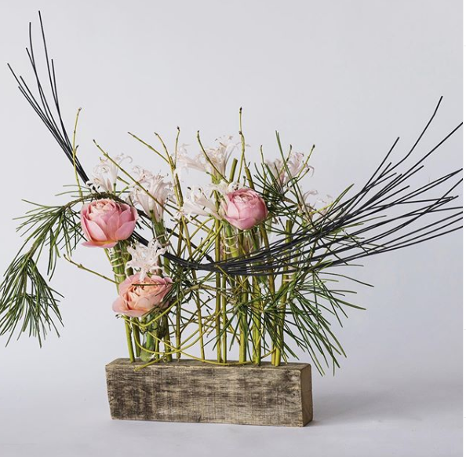
Contemporary
Paul Jaras

Slide 25
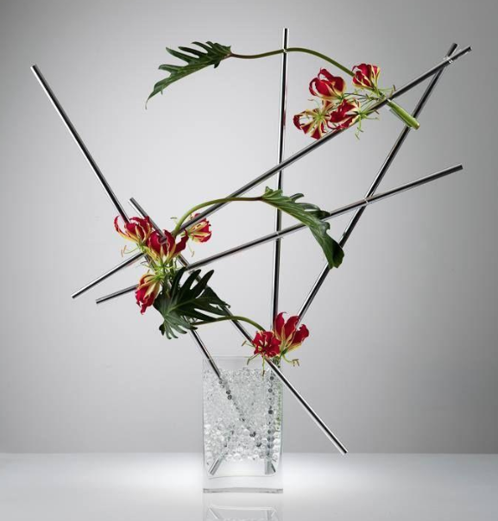
Contemporary
Hitomi Gilliam

Slide 26
Show Classes
Class One – Pre WWII (Art Nouveau & Art Deco)
Class Two – Modern
Class Three – Geometric Traditional
Class Four – Geometric Modern
Class Five - Contemporary

Slide 27
Exhibitor Display Area
Width – 30”
Height – No taller than backdrop

